Slide 1
Job Application System
MIS

Slide 2
Intro
We have split the website to 2 sections; section for users and the other for the website managers.

Slide 3
User Section
We have implemented a full system for a user where he can:
Create an account and browse the available jobs.
Apply for a job.
Post a job and view all the people who have applied for it and with their emails to communicate with them.
Edit your jobs, profile, view the Jobs that you’ve applied to.
Delete the Jobs you’ve posted, delete your account thus all the jobs you posted and all your applications to other jobs.

Slide 4
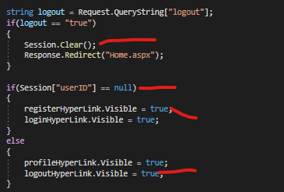
NavBar & Sessions
The website has a navbar for the user to easily navigate through the website and login/register.
The website also uses Sessions to handle who applied for what job, or the job description page.
This code runs on every Page_Load() function
Clear all the sessions on logout
This is the code behind the navbar and sessions logic
Checks if the user is logged in (have a user session)
Disables or enables the register/login and profile/logout links

Slide 5
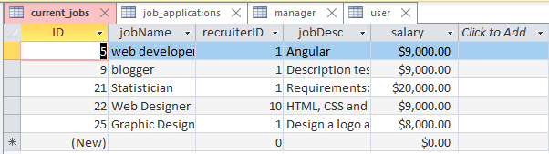
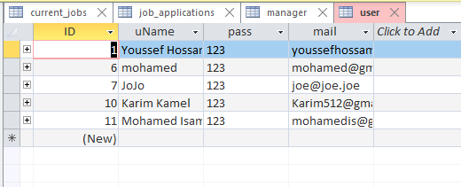
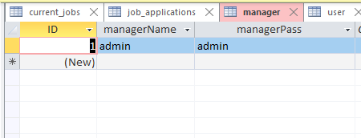
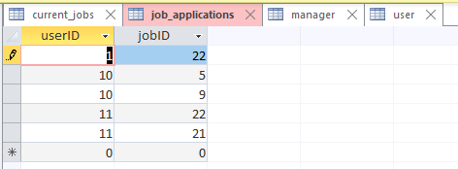
Database
Current Jobs table stores all the jobs and the id of the user who posted them
User Table stores information about all users and their password
Manager table stores the username and password of the manager to login In the manager side of the website, these values are manually inserted into the database
Job_applications is a table that links the user ID with the ID of all the jobs that he has applied to, so we can know what jobs a user has applied to.

Slide 6
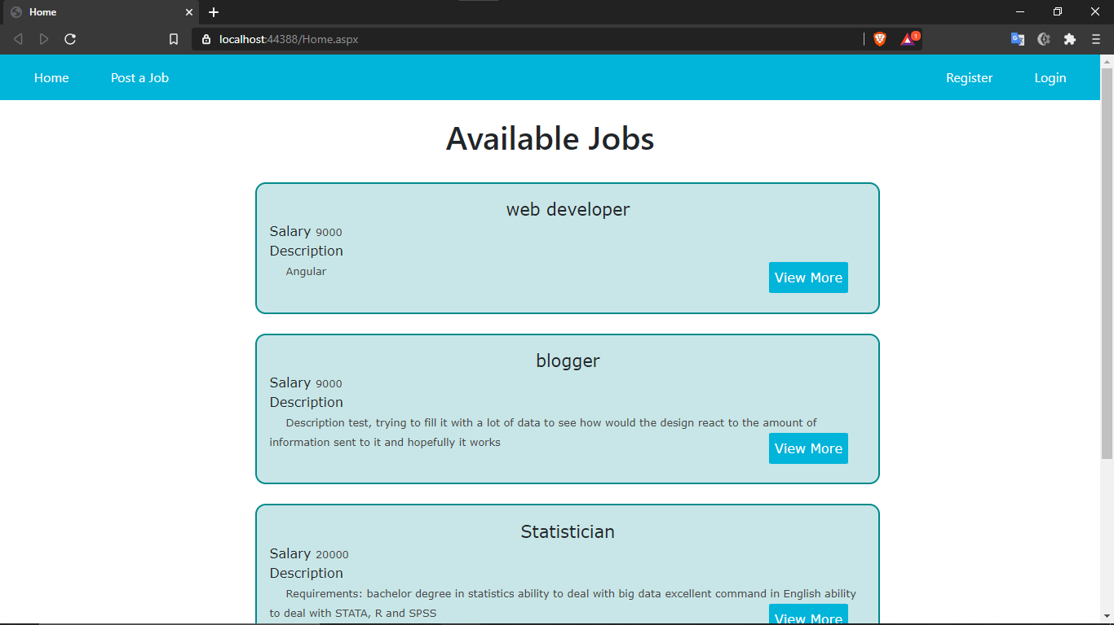
Home Page
The Home page displays all the available jobs from the database, allowing you to see the description of each job by pressing the View more button.

Slide 7
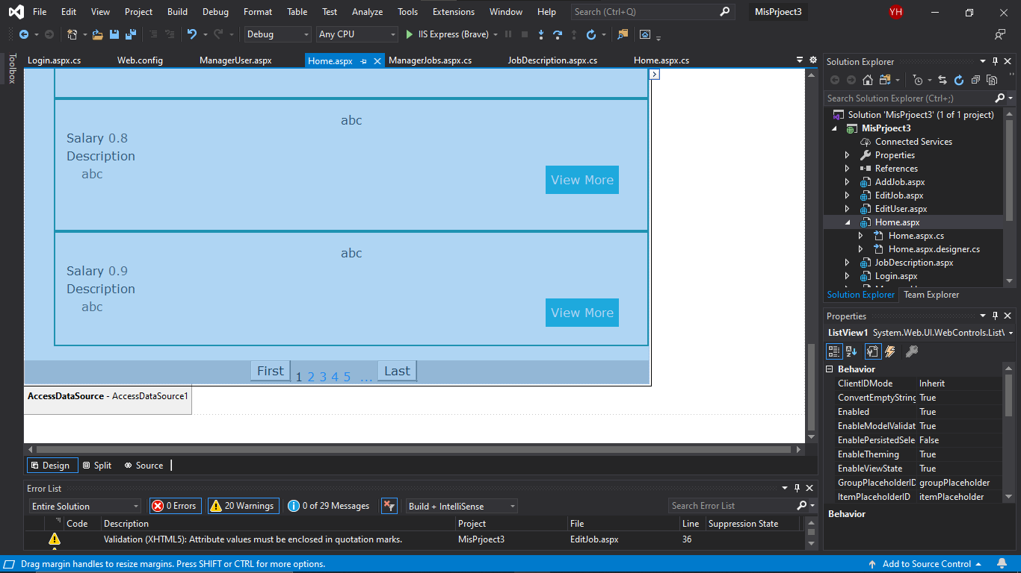
We were able to display the jobs using a list view and an access data source

Slide 8
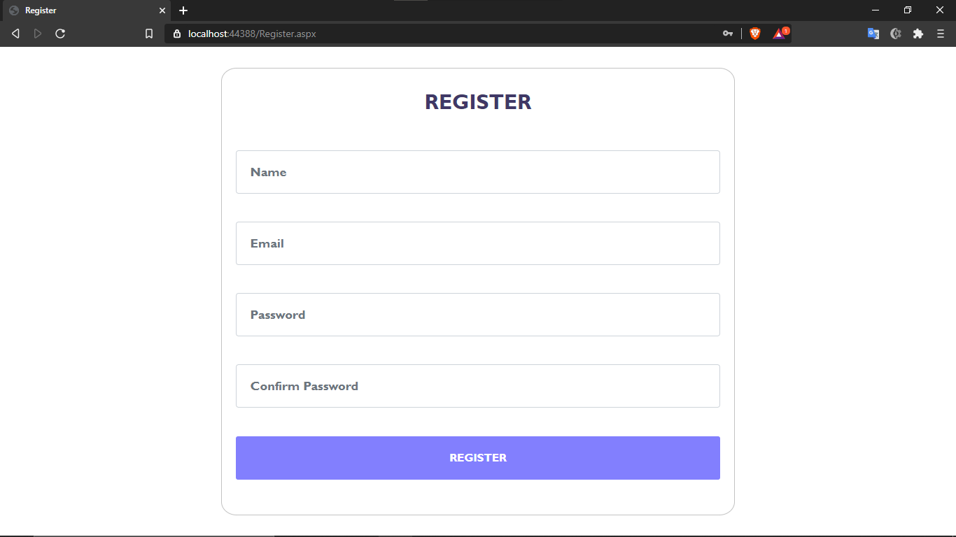
Register
The register page lets you create a new account on the website.
The page has field validators on every input field, to check if the user entered a valid email, if the confirm password matches the first password and to check if any of the fields is empty.
Once the user registers, he gets logged in and redirected to the home page.

Slide 9
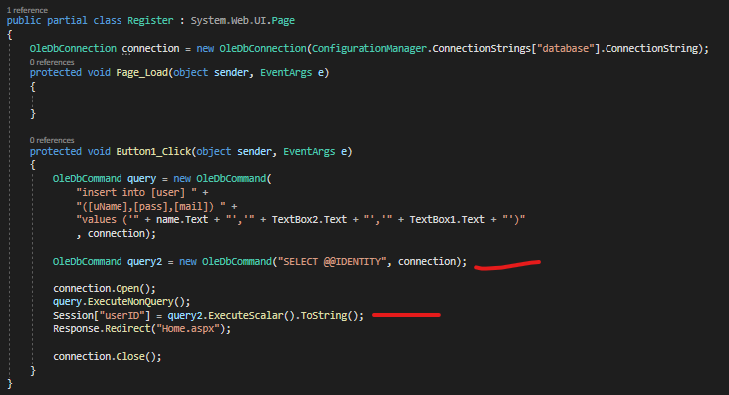
This query returns the last inserted item in the database
We use it to get the ID of the recently registered user
Creates a session with the userID

Slide 10
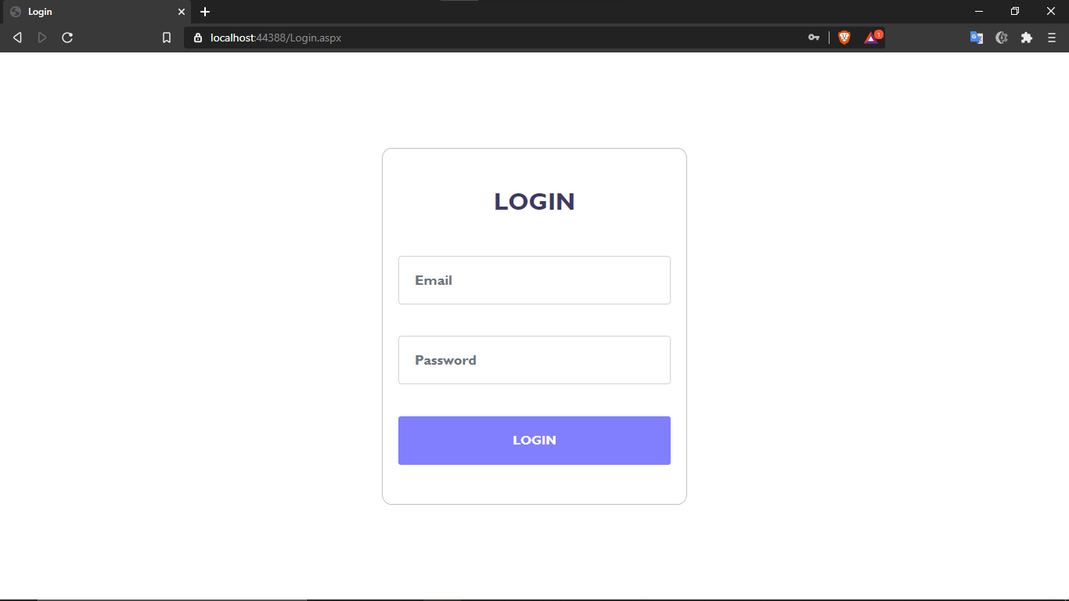
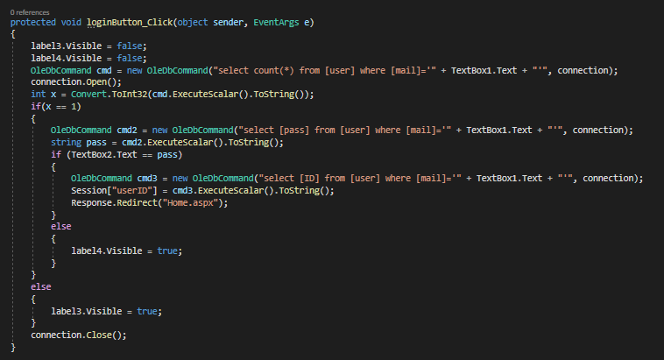
Login
The login page can be accessed through the navbar, we compare the email and password values in the database and if there is a match we redirect the user to the home page and start a session that holds the value of the user’s ID

Slide 11
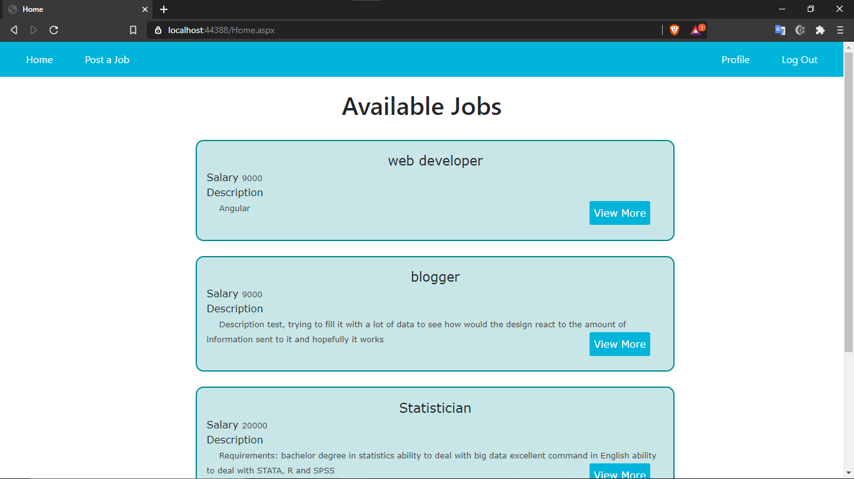
Login
Once we log in the navbar links changes from login and register to profile and logout, at this point we would be able to apply and post a job on the website

Slide 12
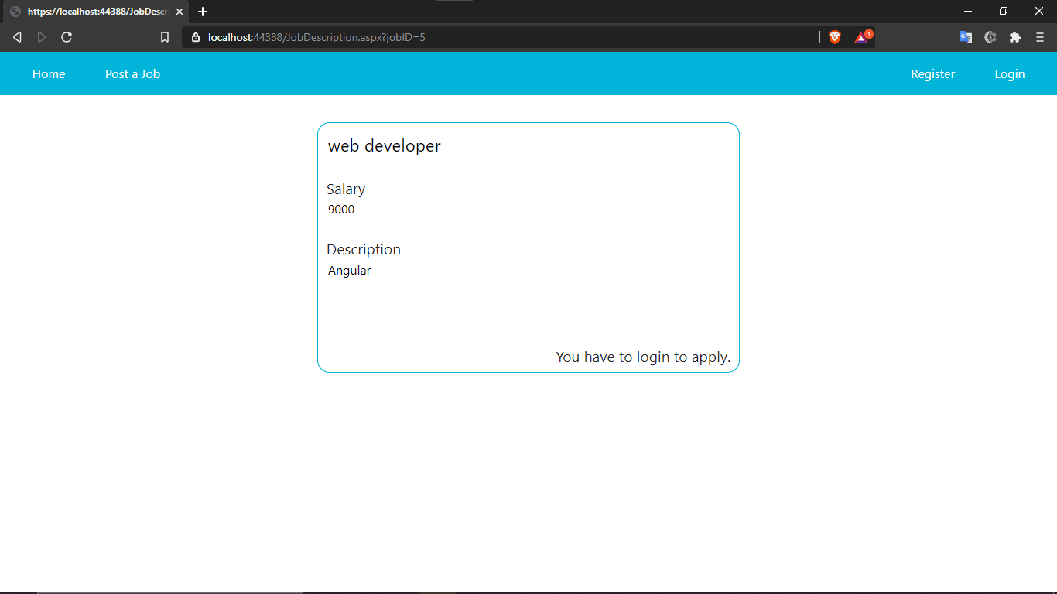
Job Description
The job description page shows the description about the selected job based on the jobID sent to it through the URL.
And based on the sessionID (if one exists) the page renders the apply button and if the user is the one who posted the job, it renders the edit button instead and displays a list of all the people who have applied for the job followed by their email address.

Slide 13
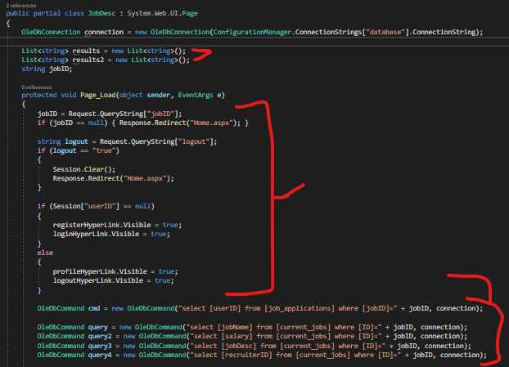
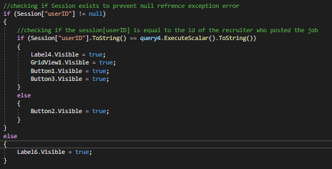

Lists to hold the value that we’ll get later
Navbar and session logic
Queries to get data about the job
Executes the commands and displays it

Slide 14
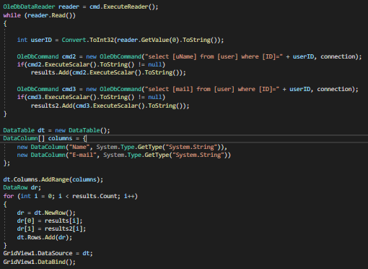
We have a database table that links between the ID of the users who have applied for the job and the ID of this job, to be able to tell who applied for what job and we called this table job_applications
Here we run this command
Which gets all the userID that have applied for this job and we store them in a data reader.
Then for each one we get from the user table the name and the mail of that user to display it to the user (if he is the one who has posted the job)
We store the values in the list variables that we have created earlier.
Now we create a new datatable for the grid view then we feed data to the datatable from the list variables and finally bind the data table to the grid view

Slide 15
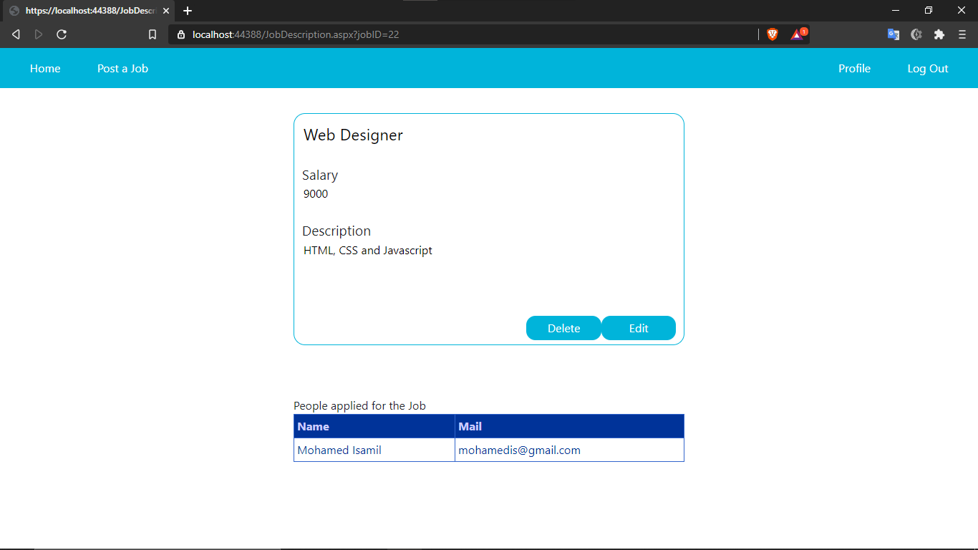
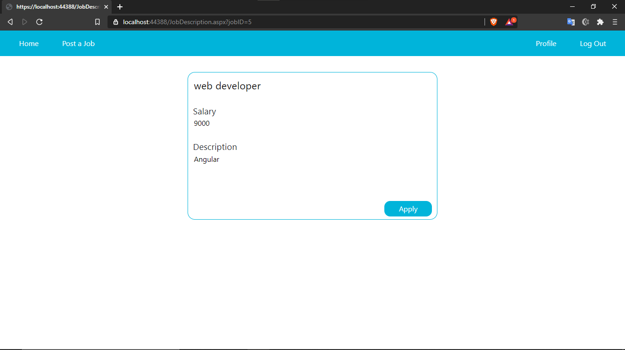
Once we login we would be able to apply in any job but if the user is the one who has posted the job he gets an edit and delete buttons instead and a list of all the people who have applied for the job.

Slide 16
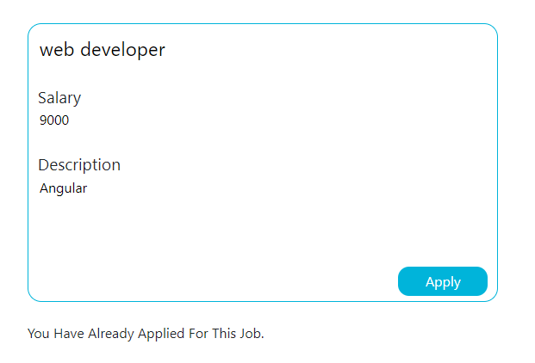
Job Description
if the person is trying to apply to a job that he has already applied to before, the system recognizes this and inform him with that

Slide 17
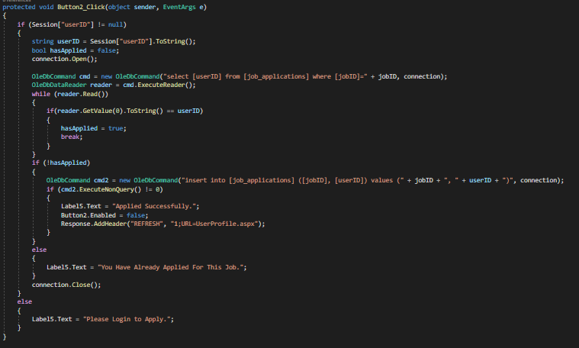
And here is the logic behind it, simple, if this user id and this job id already exist on a row in the job applications table then he has applied before.

Slide 18
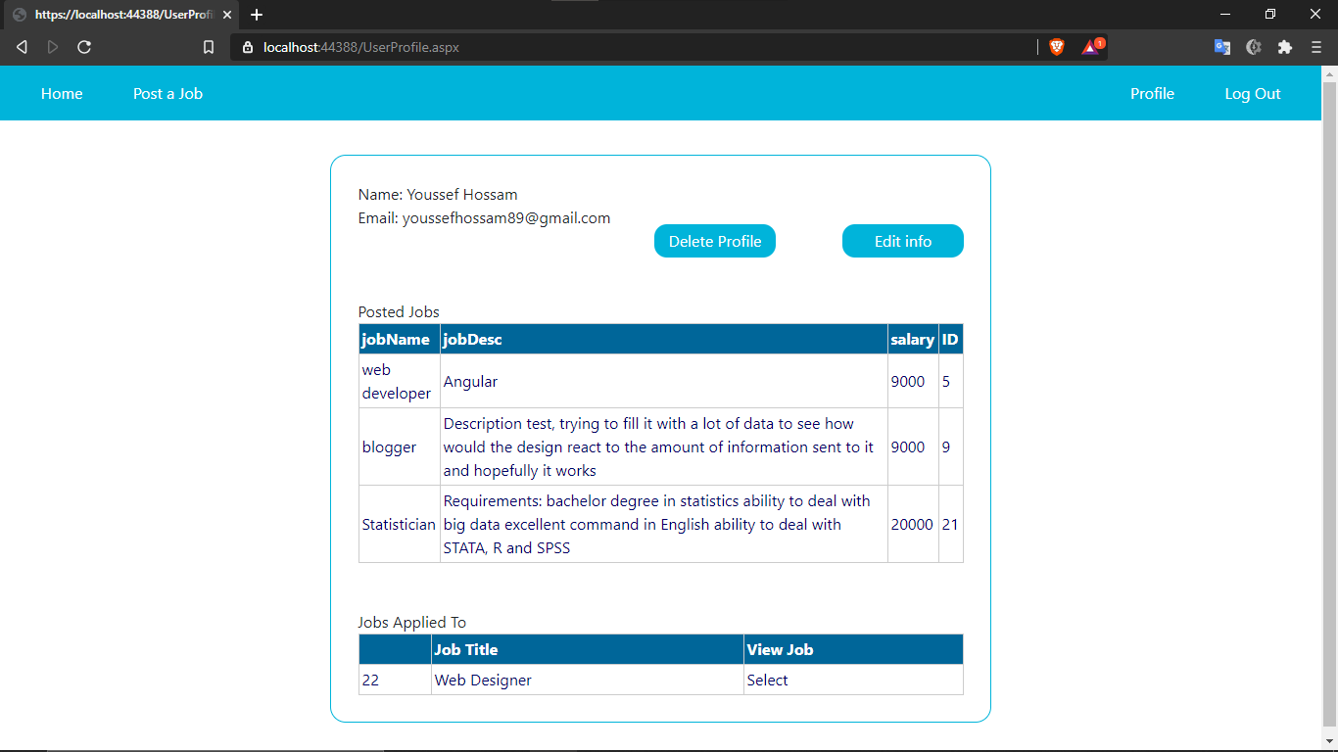
If we press Apply on a job it tells you that you have applied successfully and after a second it redirects you to the UserProfile page (your profile)

Slide 19
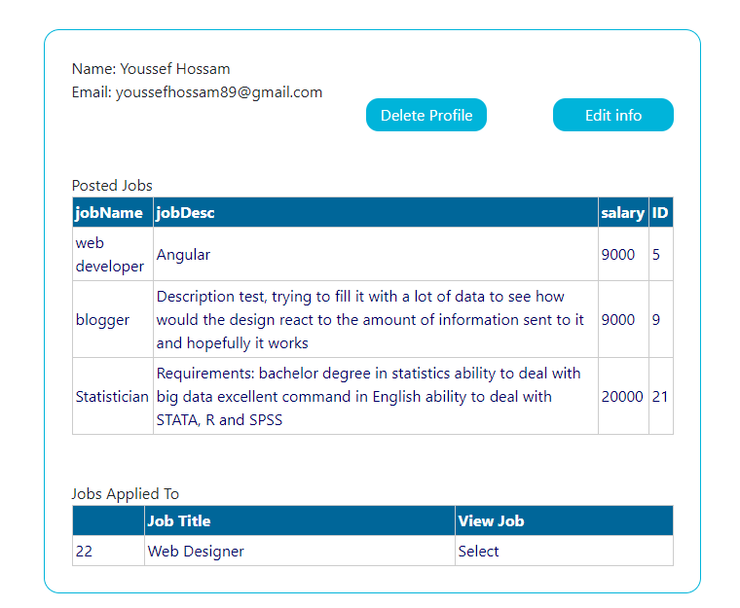
User Profile
The profile page displays all the info about you, it can only be access by the user himself, it displays the name, email, the jobs that you have posted, and jobs that you have applied to with a link to the job description page
It also enables you to edit your profile values, or delete your profile

Slide 20
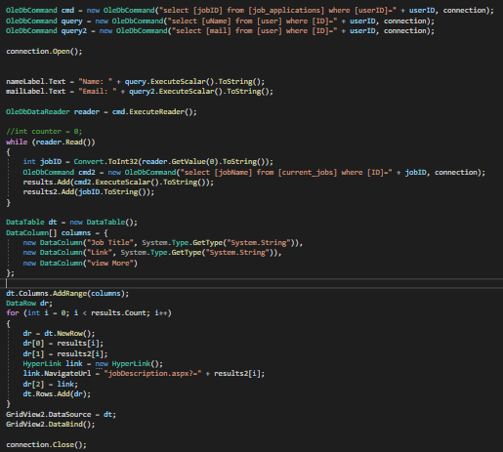
The user profile page logic is similar to the job description logic, we get the data and display it in the same way.

Slide 21
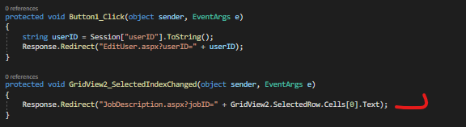
The edit user button redirects the user to the edit user page and add a query string in the URL with the specified userID that have to be edited.
Once the user selects a job in the grid it redirects him to that job
And the edit user page gets the value from the url using this code:
The variable name is jobID but it’s used to store the userID, we’ve just copied and pasted the code from the edit job page as it uses the same logic

Slide 22
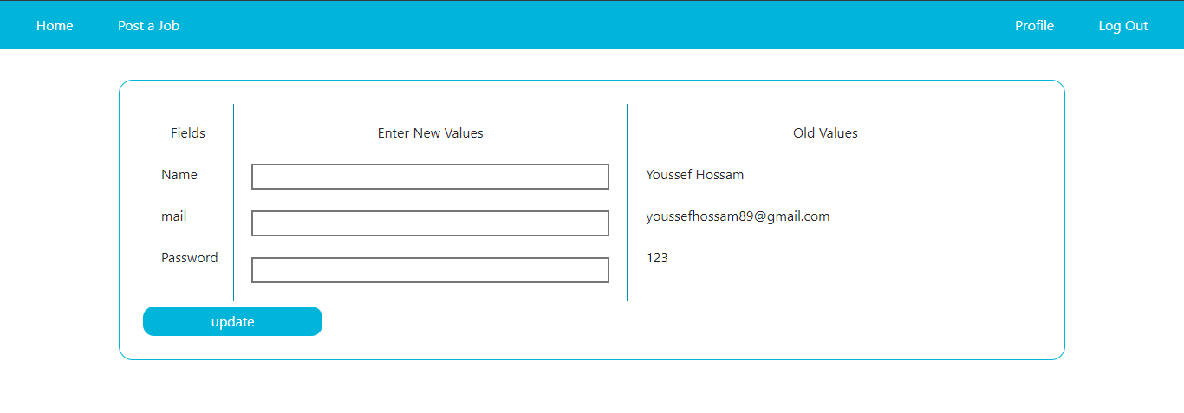
User Edit
If we press on the edit info button it takes us to the user edit page where we can edit the user info, it displays the old values (the values that currently exist) and gives you a field to enter the new values that you want to change.
If we leave any of the fields empty, it will ignore the field and only update the fields that you have typed into.
It also have a filed validator for the mail to enter a valid email address.
Note: all of this is based on the sessions that we have implemented earlier.

Slide 23
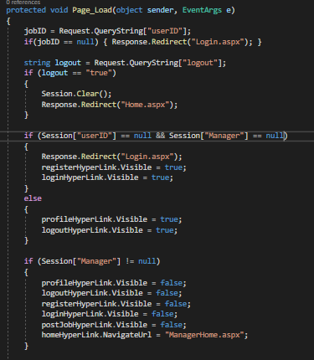
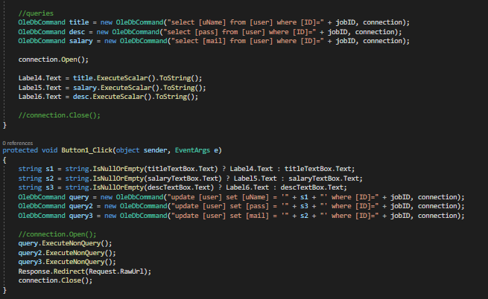
Next to the ordinary navbar logic, we have added some logic for the manager as he can access this page, we made the navbar flexible and it can react to withier the person viewing this page is a user or a manager and it changes itself based on that.
The rest of the code is straight forward, we get the old values from the database and displays it to make it easy on the user to remember the old values.
Then on the button click we check if the textbox was empty and if it was, we use the old values instead of updating the value to be a blank.

Slide 24
User Delete
The delete button in the user profile deletes the user from the database including all the jobs that he has posted and all his applications to other jobs (he won’t be displayed in the list that displays the people who have applied for the job of other users)

Slide 25
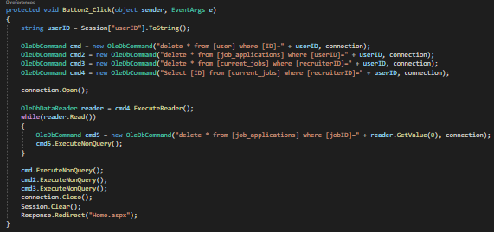
The delete user button work as follows, it deletes the user from the user table in the database, it deletes all the jobs that he has posted, it also deletes all the applications that he has made to other jobs then it clears all the sessions and redirects the user to the home page.

Slide 26
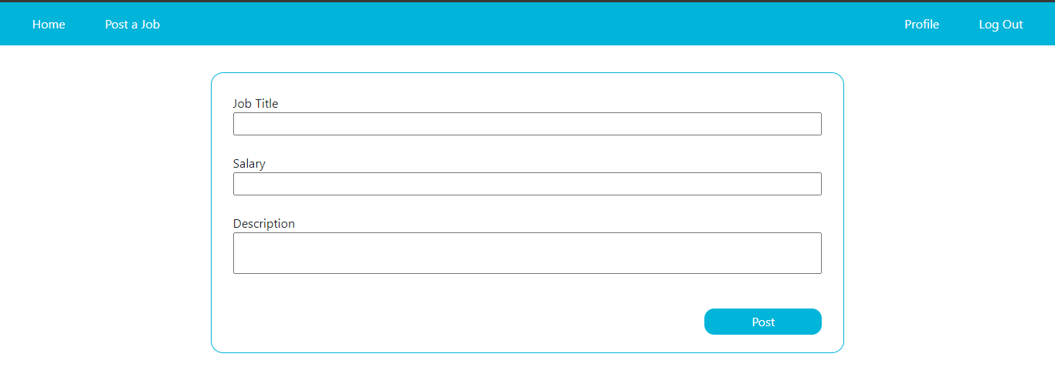
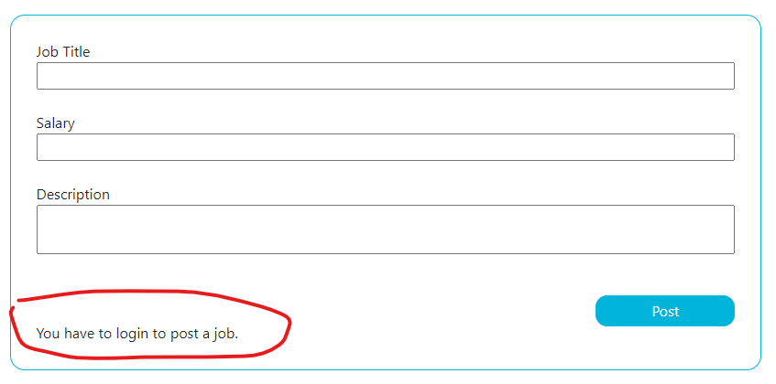
Post a job
We’ve added the option for the user to post a job, he would enter the job title, salary and description about the job. The system records it to the database and link the user ID to this job.
And of course, you must be logged in to post a job.

Slide 27
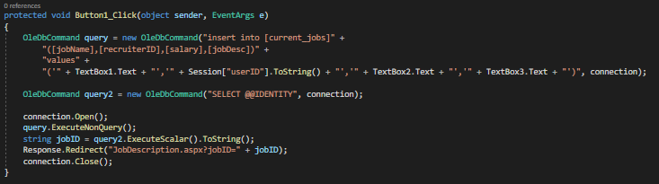
This is the logic behind it:

Slide 28
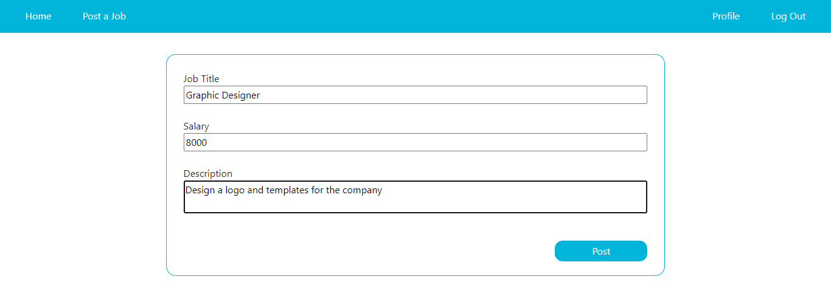
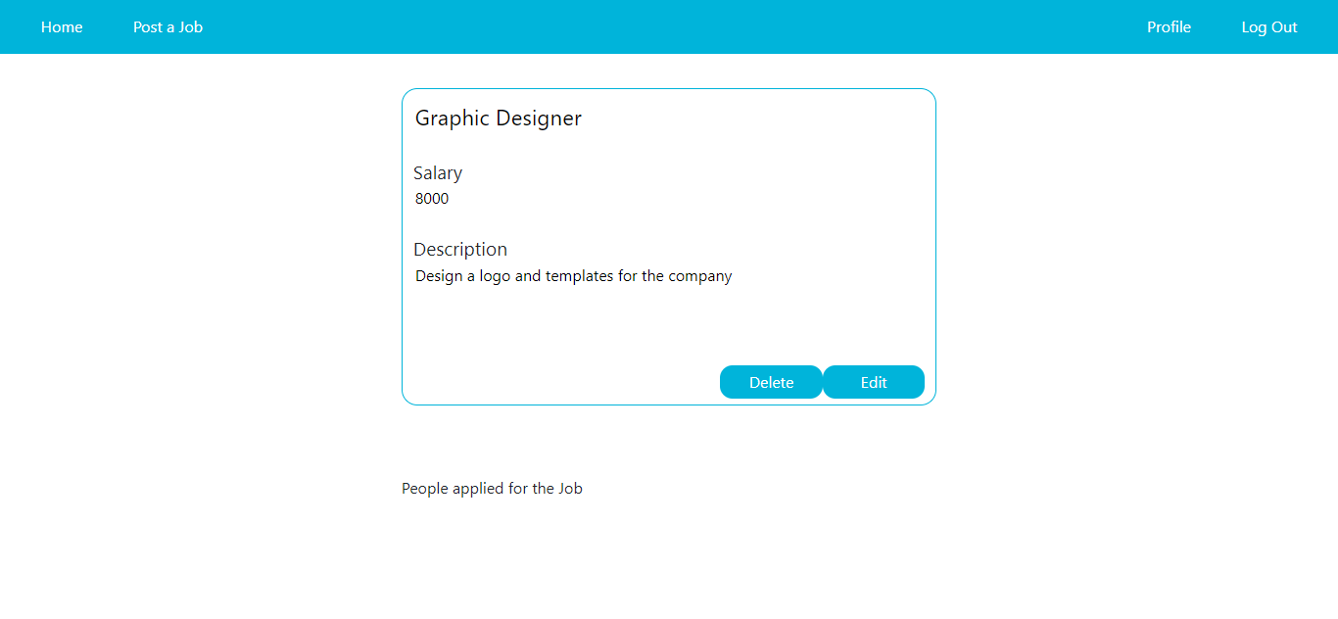
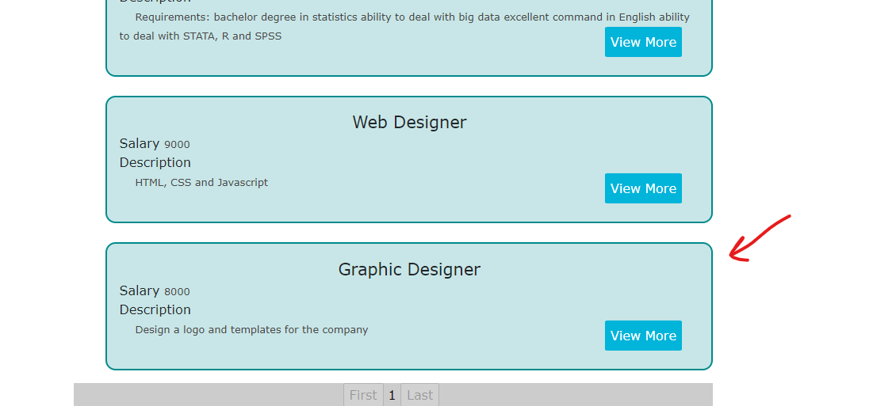
Let us post a job.
Once the job gets added to the database we get redirected to the job description page of the job that we’ve just posted.
And of course, because we’re the one who posted this job we get the edit and delete button.
And finally, if we go the home page and scroll down, we’ll see our job displayed.

Slide 29
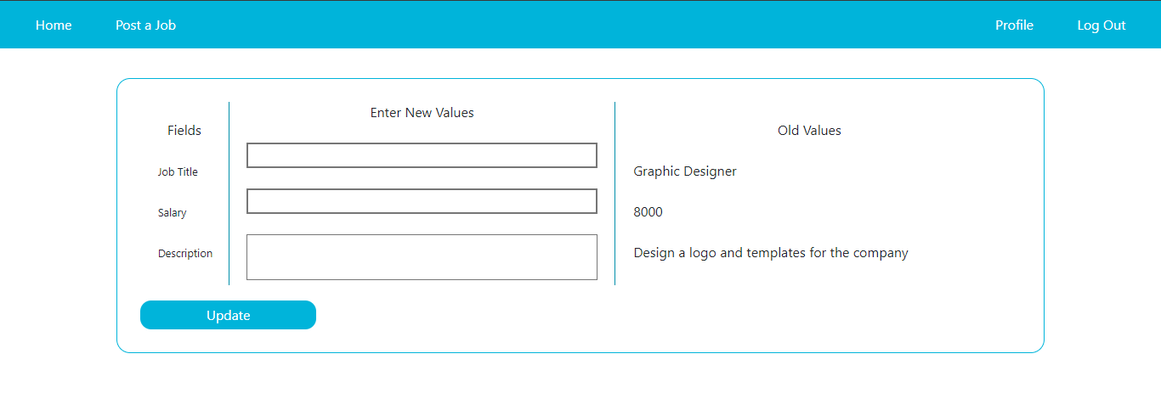
Edit & Delete Job
Just like the edit user page, the edit job work in the exact same way.
And the delete button just deletes the job from the database.

Slide 30
Manager Section
The manager have full control on the website’s database;
The manager can Edit user info.
Delete Users.
Edit Jobs.
Delete Jobs
And everything is displayed smoothly and easy to control.

Slide 31
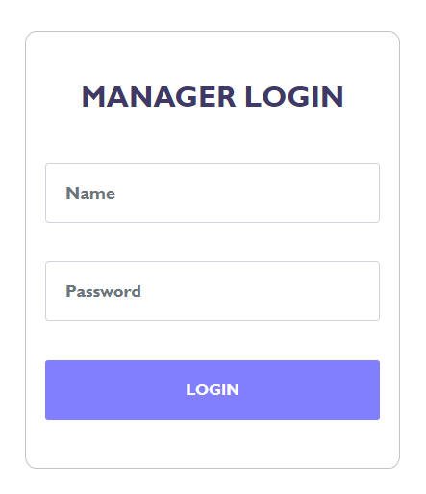
Manager Login
Just like the user login, it compares the values with the database in the manager’s table, and it redirects to the manager home page.
But unlike the user the manager does not have a registration page, instead the name and password must be manually inserted into the database.

Slide 32
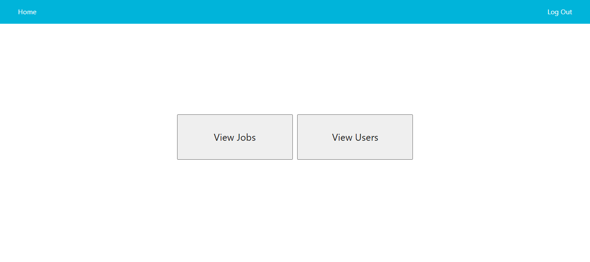
Manager Home
The manager also have a navbar but it is different than the user’s one, it only have a Home and Logout links.
The home link takes you to this page (manager home) and the logout ends all the manager sessions and redirects you to the manager login page.
In the manager home page you can view both the jobs and the user.

Slide 33
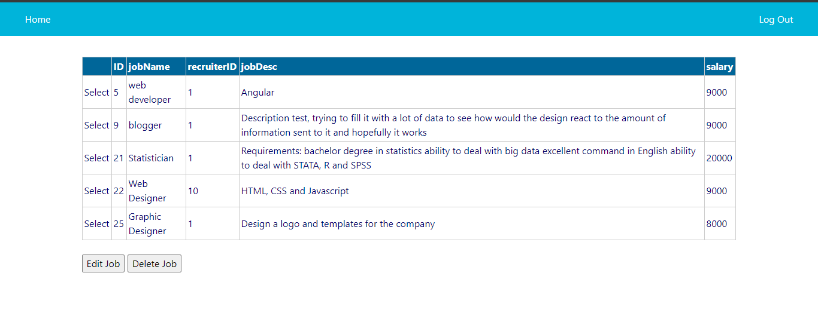
Manager view Jobs
The manager view jobs page allows you to view all the jobs in the database. you can edit or delete them as you wish, just by selecting the job and pressing the button.
The edit button takes you to the edit job page, the same page that the user can access thus, the same logic and code

Slide 34
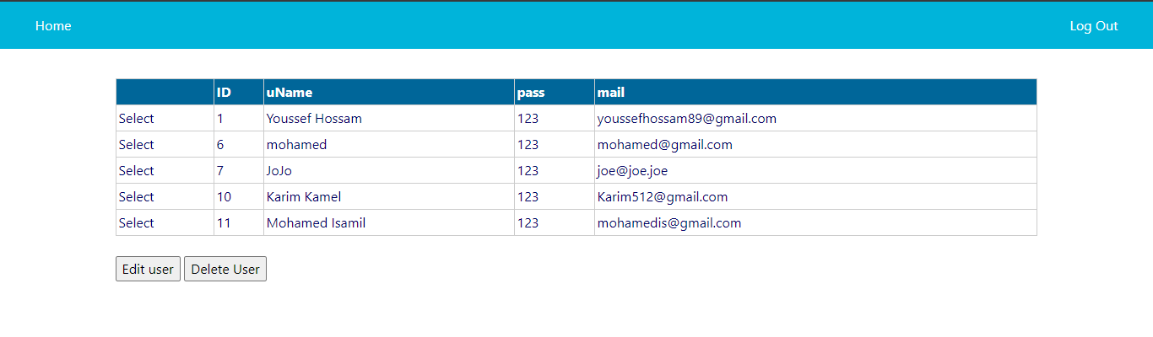
Manager view Users
In this page the manager can also edit and delete the users and it works in the same way as the manager view jobs page

Slide 35
Places to update the database location.
Web Config (2 connection strings)
AccessDataSource1 in home page
AccessDataSource1 in userProfile page
The database file is in the main project folder with all the other files, named “Database1.mdb”

